Slide 1
What school event
do you want to enjoy?
I want to enjoy the ～ .

Slide 2
entrance ceremony
入学式

Slide 3
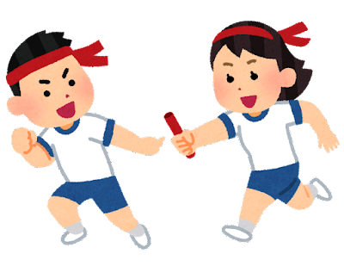
sports day
体育祭

Slide 4
school festival
文化祭

Slide 5
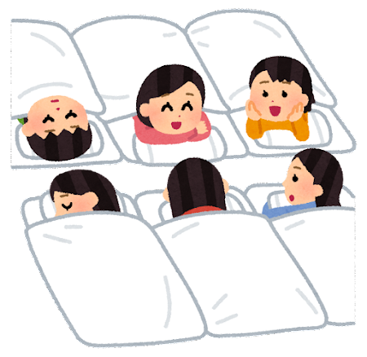
school trip
修学旅行

Slide 6
work experience
職場体験

Slide 7
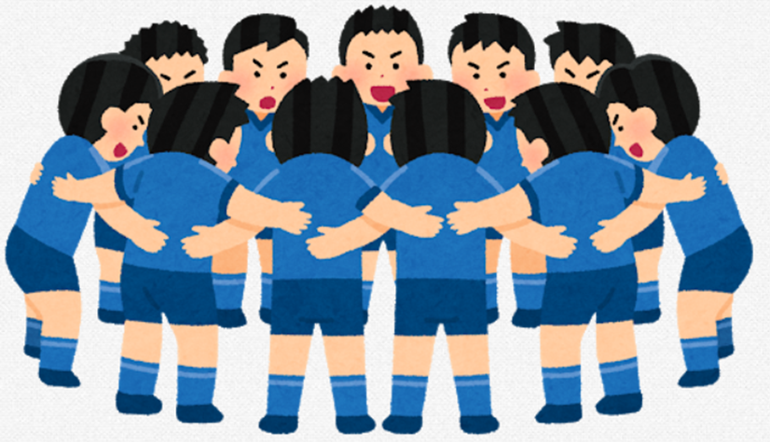
class match
クラスマッチ

Slide 8
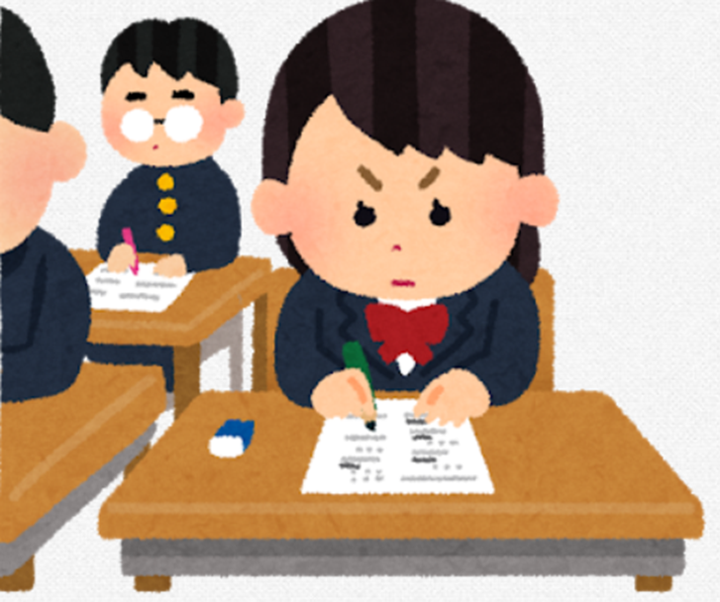
midterm test (exam)
中間試験

Slide 9
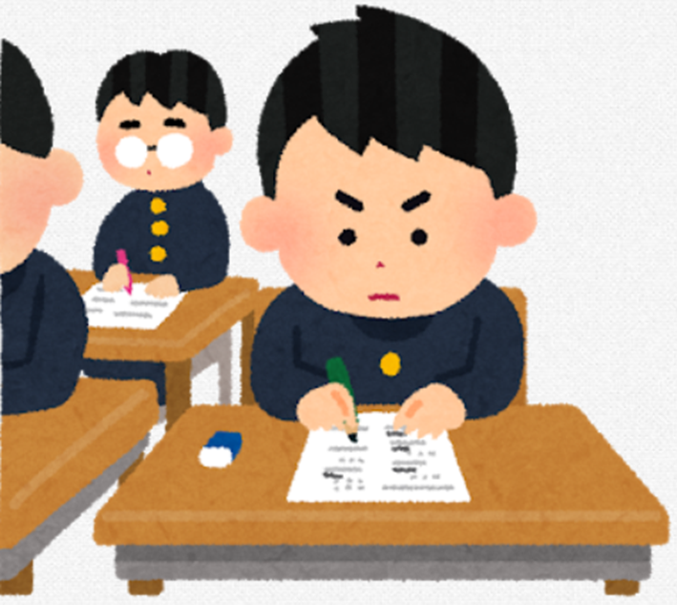
term-end test (exam)
期末試験

Slide 10
year-end test (exam)
学年末試験

Slide 11
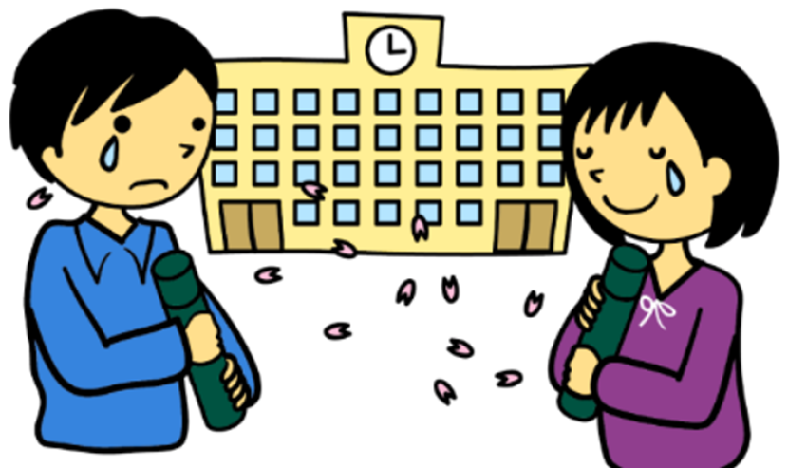
graduation ceremony
卒業式

Slide 12
What school event
do you want to enjoy?
I want to enjoy the ～ .

